Slide 1
Use RMarkdown and version control for reproducible data analysis
Yanxian Li
Group meeting presentation
27.05.2019

Slide 2

Presentation outline
Introduction to R and RStudio
Code demo: reference gene stability evaluation
RMardown and its extensions
Git and github for version control
Useful resources

Slide 3
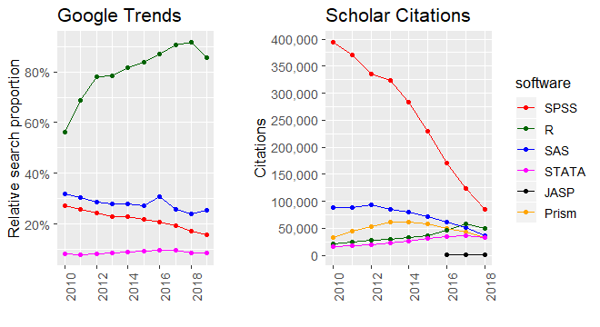
Why R?
It’s free and popular
Tons of packages and documentatons online
Reproducible data anaylsis and visualization
Source: Jonas Kristoffer Lindeløv

Slide 4
RStudio
Source: Jon Bråte

Slide 5
Live code demo in RStudio
Data import and tidy
Exploratory analysis
Modelling (not included)
Visualiztion

Slide 6
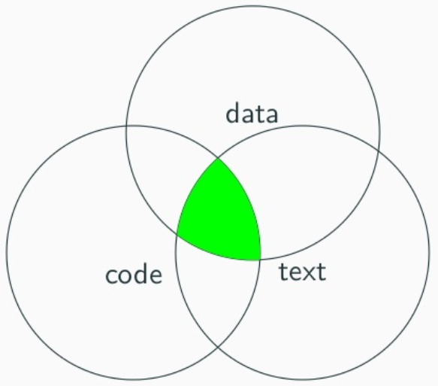
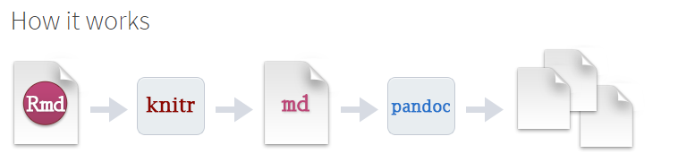
Literate programming with RMarkdown
Source: Sahir Bhatnagar

Slide 7
Rmarkdown extensions
Blogdown: building websites
Personal, organization
Bookdown: writing books
Books, thesis
Rticles: writing papers
example
Xaringan: presentations
example
Pagedown: paged html, article, Resume, Posters, Business cards

Slide 8
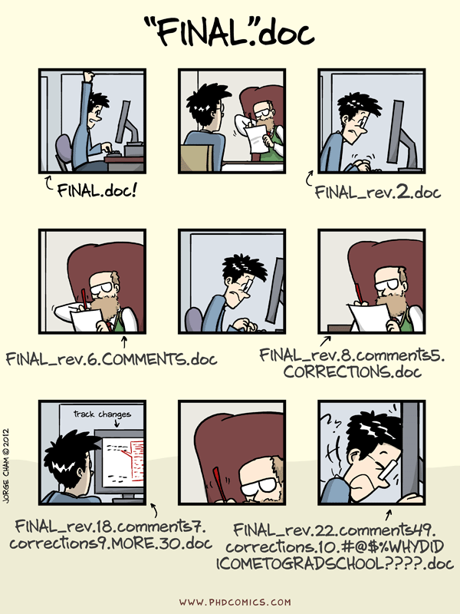
Git and github for version control
By Jorge Cham

Slide 9
Git and github for version control
Git: a version control tool
GitHub : a platform for project organization, including version control, issue tracking, code reviewing, and much more.
Free
Public/private repository
File size limitation: 1 Gb for repository, 100 M for files
Make your code citable with Zenodo
Live demo in RStudio

Slide 10
Learning resources
Entry courses for R:
Coursera courses: Statistics with R, Data Science
RYouWithMe by R-ladies Sydney
RMarkdown
Reference guide for Knitr and Rmarkdown by Yihui Xie
Getting started with R Markdown by Garrett Grolemund
Advanced Rmarkdown by Yihui Xie
Github
Riffomonas project by Pat Schloss
Happy Git and GitHub for the userR by Jenny Bryan

